Slide 1

Book Re-use
Mini-Project (PMC2216)
Glenn George Thomas (22PMC124)
Notes:
NOTE:
To change the image on this slide, select the picture and delete it. Then click the Pictures icon in the placeholder to insert your own image.

Slide 2

Content Layout
Abstract
Project Requirements
Features and highlights of project
Technical Aspects
Architecture of the project
Database
Challenges faced during the development
Important Screenshots with explanation
Future enhancements
Conclusion
References

Slide 3
Abstract
Book Re-Use is a website which is intended for those people who love reading books and also for those people who doesn’t need the books for a long period of time.
The book which is useless for us might be useful for others and both the buyer and seller will have to spend only less amount of money on the books that they need.
The seller can put his/her book’s information, his/her contact information, location, and also the price of the book.
Similarly, The buyers can contact the sellers from the contact information provided in the application. When the book is sold, the seller can delete all the information about that book.
Therefore, this website will be helpful for all those people who are in their studying phase and for those book enthusiast who loves reading new books.

Slide 4
Project Requirements
Users can:
Registration & Login
Sell Book
Buy Book
Payment
Request Book
About Us
Contact Us
Admin can:
Add Book
Delete Book
Update Book
Add User
Delete User

Slide 5
Features & Highlights
Registration & Login : The user will be able to register themselves using Django users. The user will be redirected to the user home page after logging in.
Sell Book : An authenticated user can list any available book that they wants to sell through this website.
Buy Book : An authenticated user can buy any book that is listed for sale through this website.
Payment : Payment processes through a dummy payment gateway if an authenticated user wants to buy any book that is listed for sale .
Request Book : An authenticated user can request for any book that the user wants. The request is send directly to the admin.
About Us : This page provides the user a short description about the functionalities and features of the website.
Contact Us : This page can be used by the users to contact the admin if they face any technical issues in the website.

Slide 6
Technical Aspects
Django Framework : The Django web framework is a free, open source framework that can speed up development of a web application being built in the Python programming language.
Third-Party Libraries
Third-party applications and libraries in Django are pre-built components or packages developed by the community or other companies that you can use to extend the functionality of your Django projects.
The third party libraries used in my project is:
Django Jazzmin : Jazzmin is intended as a drop-in app to jazz up your django admin site, with plenty of things you can easily customise, including a built-in UI customizer.

Slide 7
Technical Aspects
Django Crispy Forms : Django-crispy-forms defines another powerful class called Layout , which allows you to change the way the form fields are rendered. This allows you to set the order of the fields, wrap them in divs or other structures, add html, set ids, classes or attributes to whatever you want, etc.
Django Pillow : Pillow is a free, open-source library for the Python programming language that provides support for opening, manipulating, and saving many different image file formats. Pillow offers all types of image processing capabilities like image transformation, rotation, resizing, statistics of the image, etc.
Class Diagram
Class diagrams are the blueprints of your system or subsystem. You can use class diagrams to model the objects that make up the system, to display the relationships between the objects, and to describe what those objects do and the services that they provide. Class diagrams are useful in many stages of system design.

Slide 8
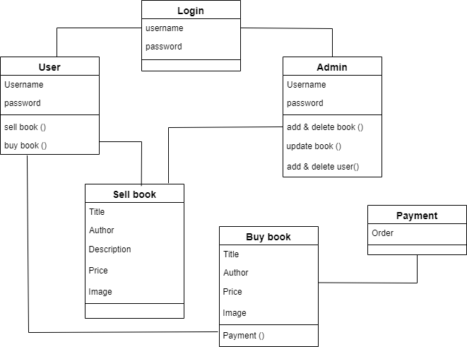
Technical Aspects (Class Diagram)

Slide 9
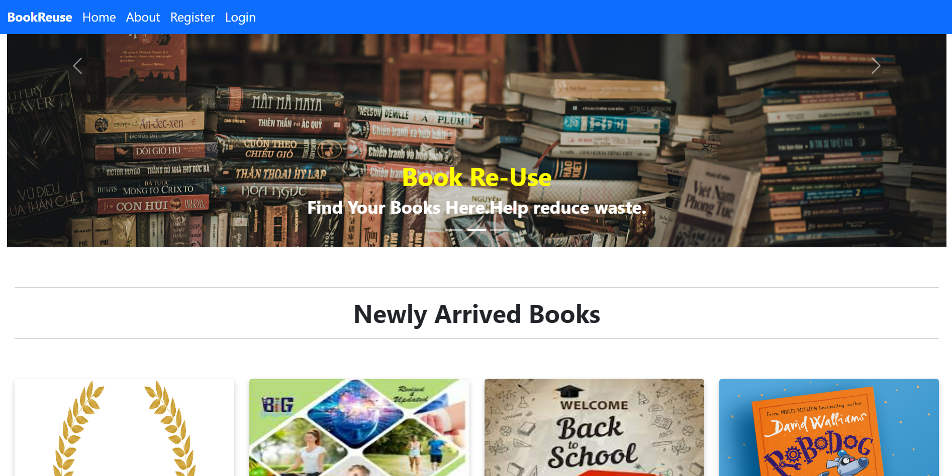
Important Screenshots
Home Page

Slide 10
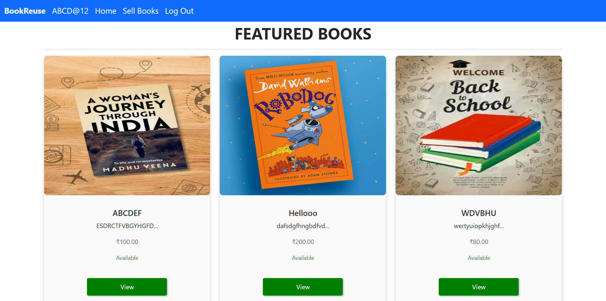
Important Screenshots
User Home-Page

Slide 11
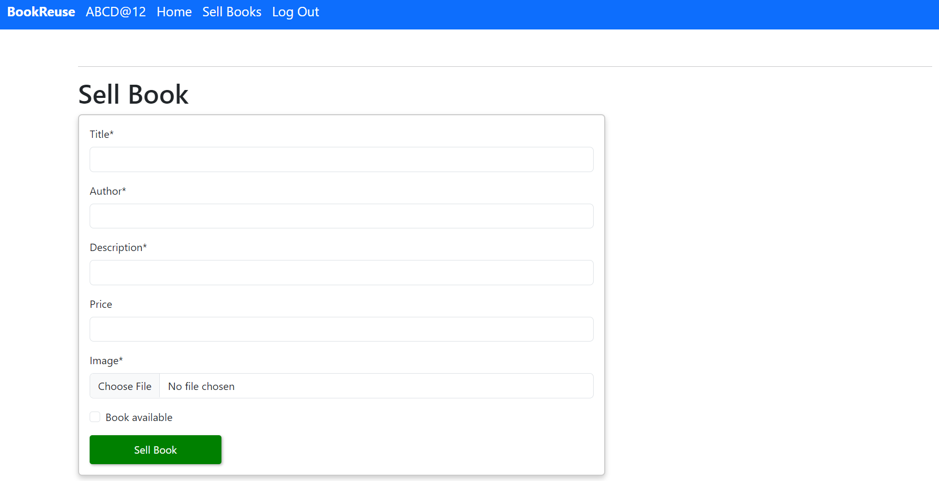
Important Screenshots
Sell Book

Slide 12
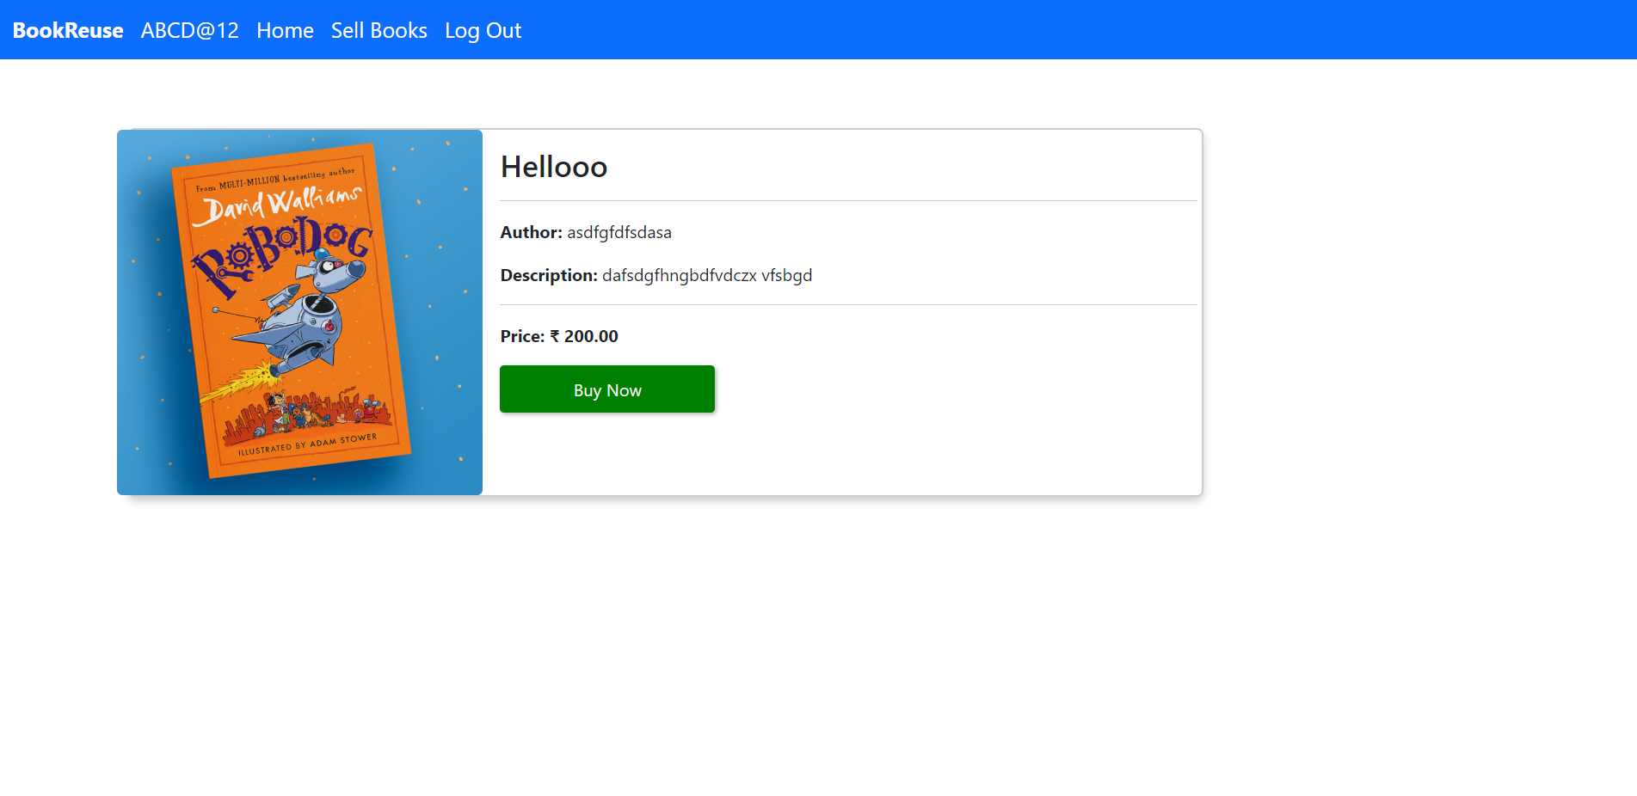
Important Screenshots
Buy Book

Slide 13
Future Enhancements
Live Tracking : The live tracking of the books that are bought by a user can be implemented in the future.
Payment : Can implement a enhancement where the payment is redirected to the sellers of the book.
Mobile Application : Mobile app for the website can be implemented in the future for the convenience of all book loving users.

Slide 14
Conclusion
Book Re-Use is a website which is intended for those people who love reading books and also for those people who doesn’t need the books for a long period of time. The book which is useless for us might be useful for others and both the buyer and seller will have to spend only less amount of money on the books that they need. Therefore, this website will be helpful for all those people who are in their studying phase and for those book enthusiast who loves reading new books.

Slide 15
References
https://docs.djangoproject.com/en/4.2/
https://getbootstrap.com/docs/5.0/getting-started/introduction/
https://django-crispy-forms.readthedocs.io/
https://pypi.org/project/Pillow/
https://django-jazzmin.readthedocs.io/
https://openai.com/

Slide 16
Thank You

